Slide 1

Unit – II
Industrial Productions
Mr. S. N. Mendhe
Department of Microbiology,
Shri Shivaji Science and Arts College, Chikhli

Slide 2
INDUSTRIAL PRODUCTION OF VINEGAR (ACETIC ACID)
Vinegar fermentation is one of the oldest fermentation known to man.
It occurs naturally as an unwanted spoilage of wines. Vinegar means the “ Sour wines” and may be defined as a food product containing not less than 4 gm. of acetic acid per 100 ml and in addition it posses flavor characteristics.
COMPOSITION OF VINEGAR -
Composition of vinegar depends on nature of raw materials, fermentation conditions, aging & storage process.
Cidar vinegar contains about 4 gm. of acetic acid per 100 ml of vinegar and small amount of alcohol, glycerol, esters, reducing sugars, pentosans, salts etc.

Slide 3
CLASSIFICATION –
Vinegar may be prepared from apples, grapes, malt etc and accordingly classified as follows –
Cidar vinegar - The vinegar made by alcoholic and subsequent acetous fermentation of apple juice.
Wine vinegar - The vinegar made by alcoholic and subsequent acetous fermentation of grape juice.
Malt vinegar - The vinegar made by alcoholic and subsequent acetous fermentation of barley malt or cereals.
Molasses vinegar / sugar vinegar - The vinegar made by alcoholic and subsequent acetous fermentation of sugar syrup or molasses.
Spirit vinegar / distilled vinegar - The vinegar made by the acetous fermentation of dilute distilled alcohol.

Slide 4
VINEGAR PRODUCTION –
The production of vinegar requires two fermentations
Alcoholic fermentation – This is the anaerobic fermentation in which ethanol is produced from sugar by utilizing the species of yeast Saccharomyces cerevisiae.
C₆H₁₂O₆ → 2 CH₃CH₂OH + 2 CO₂
At the end of alcoholic fermentation, the supernatant alcoholic broth is separated, alcohol concentration adjusted to 10 – 13 % and subjected to subsequent acetous fermentation.
Acetous or Acetic acid Fermentation - This is the aerobic fermentation in which ethanol is oxidized through acetaldehyde to acetic acid by utilizing the species of Acetobactor (bacteria).
CH₃.CH₂.OH + O₂ → CH₃CHO + H₂O
CH₃CHO + O₂ → CH₃COOH

Slide 5
MICROORGANISM USED FOR ACETOUS FERMENTATION
There are large no. Of bacteria that have the ability to produce vinegar (acetic acid) in small amount from various raw materials, but only few bacteria posses characteristic desire for vinegar production.
They includes various species of Acetobacter such as Acetobacter pasteurianus, Acetobacter acetigenum, Acetobacter orleanse etc.
Bacterium schutenbachii or Bacterium curvum may also be used. These acetic acid bacteria are Gm- ve, rod shaped, non-sporulating and obligate aerobe.
METHODS OF VINEGAR PRODUCTION
There are three methods of vinegar production
Orleans Process (Slow Process)
Fringe Process (Quick Process)
Submerged Fermentation Process

Slide 6
ORLEANS PROCESS (SLOW PROCESS)
This process was developed in Orleans, France for wine vinegar.
It is still practiced on a limited scale. In this process, the fermentation is carried out in large barrels (approx. 200 lit. capacity).
These barrels are provided with holes in the wall of vessel, above the liquid layer to introduce the air.
These holes are screened to prevent the entry of insects.
Each barrel is filled about one third with a good grade of vinegar, which constitutes the starter or culture and 10 to 15 lit of wine are added.
After weekly intervals for about 4 weeks, the same quantity of wine is added to the barrel.
When 5th week have passed, 10-15 lit of vinegar are withdrawn from the barrel and the same amount wine is introduced.
The operation may be repeated, thus becoming a slowly continuous process.

Slide 7
The Acetobacter bacteria produce considerable slime and grow as a film on the surface of alcoholic broth.
This film later becomes quite thick and gelatineous. This film, which contains very large no. of bacteria is known as “mother of vinegar”.
This thick film unless supported on a wooden frame, it will sink to the bottom of the barrel and may fail to produce acetic acid under anaerobic condition.
Therefore to prevent this, film is supported on a raft or wooden grating.
The oxidation of ethanol to acetic acid by this process is quite slow, as it requires a time period of about 1 to 3 months.
During this period other non-acetobacter bacteria becomes active and produce lactic acid and propionic acid esters which imparts an unique flavour and aroma to the vinegar.
The long incubation period also allows a high loss of ethanol through evaporation.

Slide 8
Seed culture AIR INLET
ALCOHOLIC WOODEN GRATING
BROTH TO SUPPORT
BACTERIAL FILM

Slide 9
FRINGE METHOD ( QUICK VINEGAR PROCESS )
This process is also called as packed generator process or trickling generator process or fringe generator method.
This method was developed in Germany for rapid microbial oxidation of ethanol to acetic acid.
The quick vinegar process makes the use of fringe generators.
Fringe Generators:-
The fringe generators used in this process is a large vertical tank either open or closed at the top.
The generators are provided with false perforated bottom through which the air enters.
Near the top of the generator there is a perforated top, over, which is, arranged a rotating sprinkler or sparger. This produces a uniform distribution of alcoholic broth.

Slide 10
The space between perforated top and perforated bottom is loosely packed with beech wood shavings, twigs, bamboos-stick bundles or other supporting agents.
Below the wooden grating at the bottom of generator is the collection chamber.
At the very bottom, it is provided with a cock through which product is withdrawn.
In order to control the temp, generators are provided with tubular cooling coils situated at the bottom of the tank.
The coils are connected to the sparger through a rubber feed line.

Slide 11
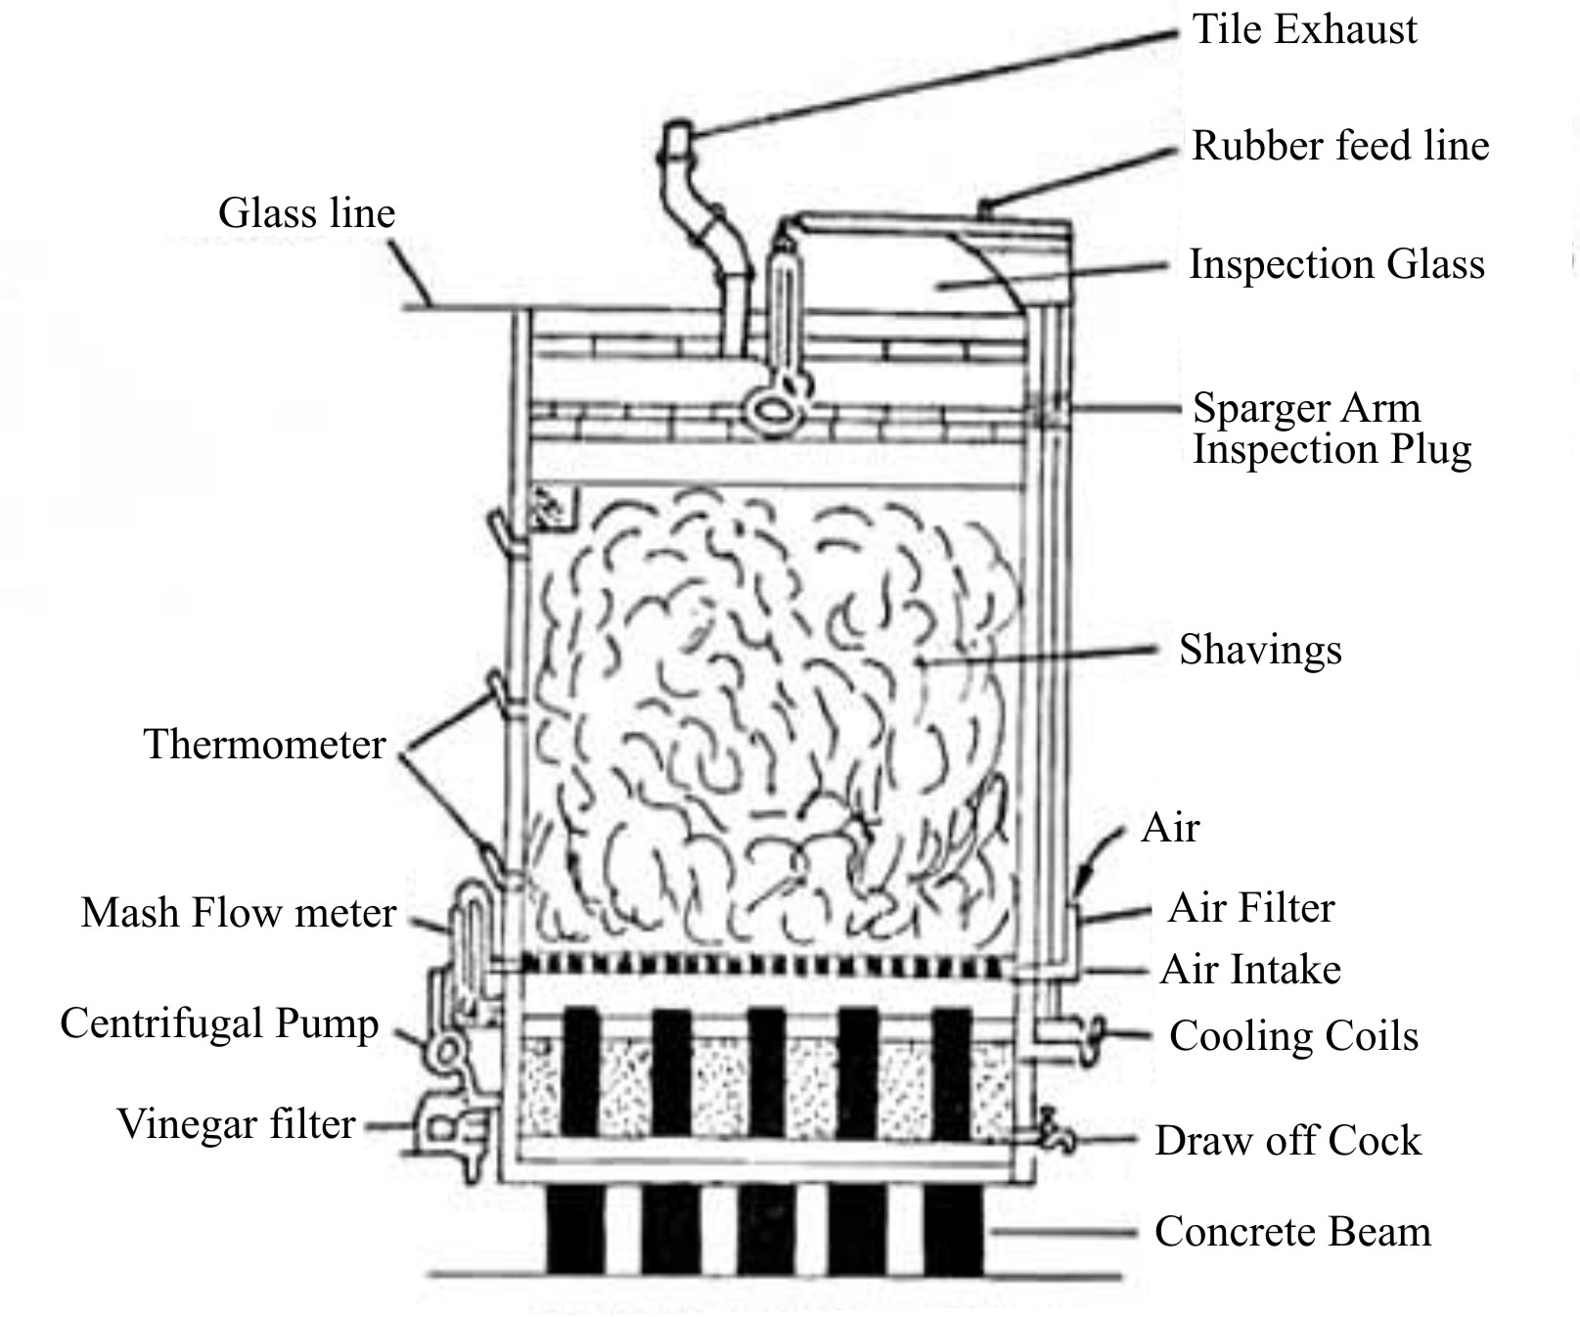
Fig 2.7 Fringe Generator

Slide 12
Operation Of Generator –
A bacterial film composed of mixed Acetobacter species, grown on the surface of the supporting agent.
The alcoholic broth is added to generator.
The broth trickles down through the shavings so as to provide contact of the alcohol with the cells and consequent oxidation of the alcohol.
Sterile air is introduced through the air inlet.
The airflows freely in the beech wood shavings from bottom to the top of the generator.
During this process heat is generated and temp is maintained to 32⁰C by circulating water through tubular cooling coils at bottom.

Slide 13
The alcoholic broth is recycled through the generator until the alcohol becomes completely oxidized and the standard quantity (15 %) of vinegar is obtained.
Once satisfactory bacterial film has been accumulated on the supporting agent, the generator can be operated continuously for several months or until contamination by the slime forming bacterium, Acetobacter xylinum becomes a problem.

Slide 14
Further Processing Of Vinegar:-
The vinegar produced in all methods is further processed in following way.
1) Storage:- Vinegar is stored in barrels or tanks, for a year or longer.
2) Aging:- Aging takes place during storage. Aging improves flavor and clarity of vinegar.
3) Clarification:- Clarification of vinegar may be done by using filter aids or fining agents.
4) Bottling and Pasteurization:- Clarified vinegar filled in bottles and tightly capped with cork to prevent entry of air.
Bottled vinegar is then pasteurized by heating bottles at 60 to 66 ⁰C for about 30 min.

Slide 15
